Slide 1


BIOMEDICAL ENGINEERING'S POSITION IN QUEBEC HEALTH NETWORK NEW STRUCTURES
¹
³
²
Gnahoua Zoabli¹, Edwige Huguette Dongmo², and Julianne Desforges³
2:30 pm on Thursday May 26th
“Cross Country Check Up Session“ in Clinical Engineering session
Stephen Room

Slide 2
Overview
Bill 10 – Quebec Healthcare Reform
General administrative structure
Clinical departments’ directorates
General Biomed Structure
Recommendations

Slide 3
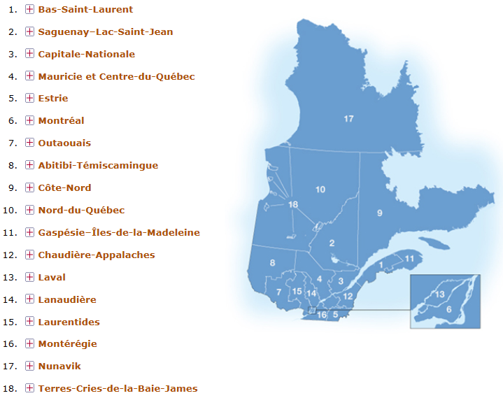
Quebec Healthcare Regions

Slide 4
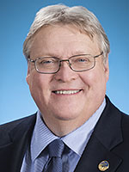
Bill 10 – Quebec Healthcare Reform
8 CIUSSS
  02- CIUSSS Saguenay-Lac-Saint-Jean
  03 – CIUSSS de la Capitale
  05 – CIUSSS de l’Estrie
  06 – CIUSSS Centre-Est-de-l’Île-de-Montréal
  06 – CIUSSS Centre-Ouest-de-l’Île-de-Montréal
  06 – CIUSSS de l’Est-de-l’Île-de-Montréal
  06 – CIUSSS du Nord-de-l’Île-de-Montréal
  06 – CIUSSS de l’Ouest-de-l’Île-de-Montréal
Integrated Academic Health Autorities

Slide 5
Bill 10 – Quebec Healthcare Reform
11 CISSS
  01 - CISSS Bas-St-Laurent
  07 - CISSS de l’Outaouais
  08 - CISSS de l’Abitibi-Témiscamingue
  09 - CISSS de la Côte-Nord
  12 – Chaudière-Appalaches
  13 - CISSS de Laval
  14 – CISSS de Lanaudière
  15 – CISSS des Laurentides
  16 – CISSS de la Montérégie-Centre
  16 – CISSS de la Montérégie-Est
  16 – CISSS de la Montérégie-Ouest
Integrated
Non-Academic
Health Autorities

Slide 6
Flow chart of a CISSS

Slide 7
Flow chart of a CIUSSS

Slide 8

Directorates of BIOMED in CISSS on august 12, 2015. (n=11)
* Counselor Vision, ** Maintenance Vision

Slide 9
Directorates of BIOMED in CIUSSS on august 12, 2015.
(n=8)
* Counselor Vision, ** Maintenance Vision

Slide 10
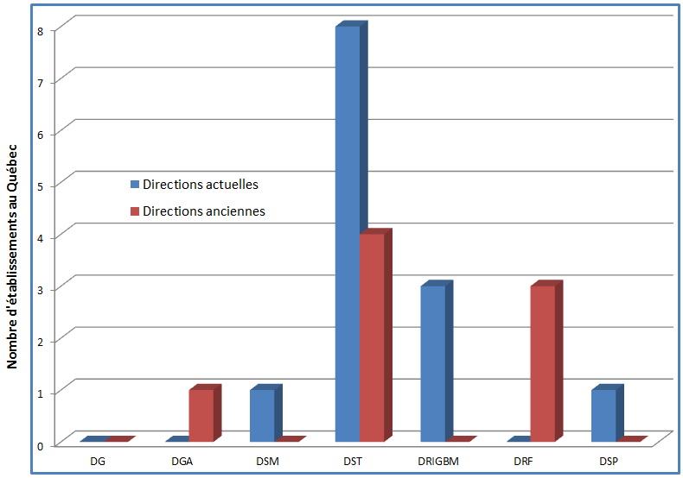
Biomedical Engineering Directorates (Nov. 2011 & previous)
13
8
*Seven (7) DST as always
One (1) DRF to DST
Trend
(quantitative)
Non-academic hospitals

Slide 11
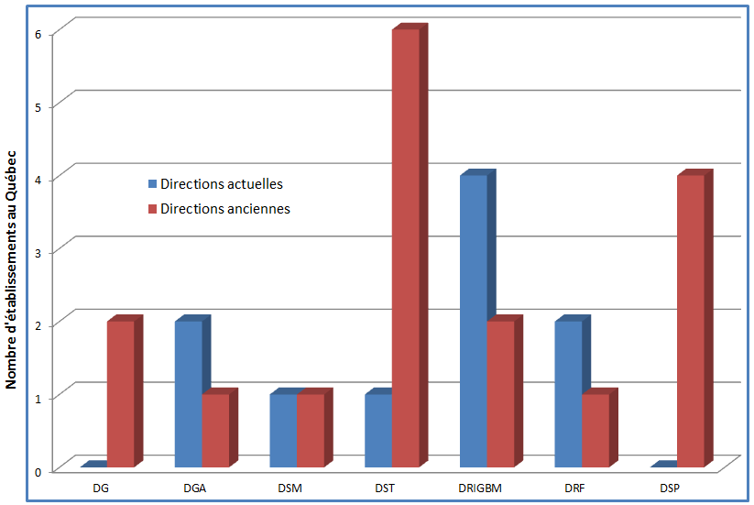
Biomedical Engineering Directorates (Nov. 2011 & previous)
10
17
*DST as always
Trend
(quantitative)
Academic Hospitals and Institutes

Slide 12
General BIOMED chart in CISSS or CIUSSS

Slide 13


Slide 14
Discussion

Slide 15
Observations
Biomed is the ONLY clinical service to have various directorates in CIUSSS and CISSS
DRIGBM (Technological) Directorate no longer exists after April 1, 2015
Structures seem local-leadership dependent
Changes are still occurring in the organizational structures

Slide 16

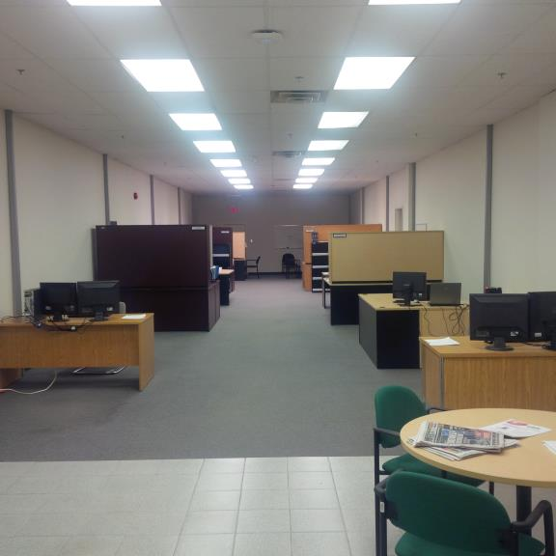
Recommendations

Slide 17
Recommended BIOMED Directorate
1
2
Directorate of Technological Services
3
All BIOMED under the same directorate in CISSS and CIUSSS
Clinical Engineering directorate

Slide 18
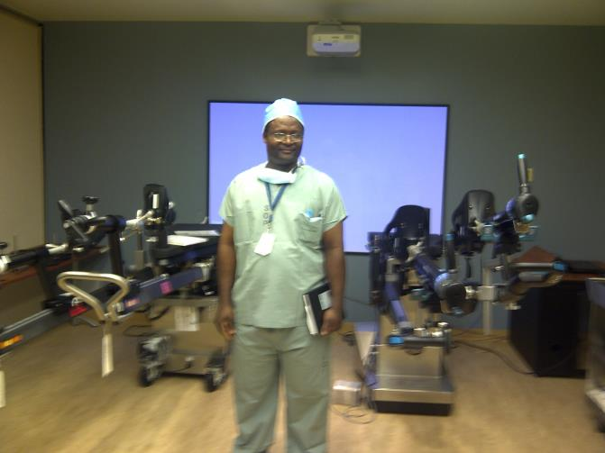
Questions ?

